Slide 1
Diversification
Endosymbiosis
Oxygenation
Notes:
What happened during the gap between earth’s formation and the origins of cellular life?

Slide 2
Prebiotic chemistry
A field of research dedicated to the study of how the building blocks of life formed spontaneously from energy and minerals present on the early earth.
Can be shown experimentally, but difficult to prove that it actually happened that way
Several schools of thought

Slide 3
How these inorganic compound converted to organic compounds?
Can happen spontaneously if these gases are subjected to intense energy sources:
1) UV radiation was the most important, because no UV-absorbing ozone layer existed. Ozone shield appeared about 2 BYA
2) Lightning discharge (Miller-Urey experiment).
3) Radioactivity (e.g. ionizing radiation from outer space).
4) Thermal energy from volcanic activity, hydrothermal vents,
or meteoritic impacts.

Slide 4
Origin of cellular life:
Two competing hypotheses: Surface versus subsurface origin.
Surface origin hypothesis
Self-replicating cells arose out of a primordial soup rich in organic and inorganic compounds in a “warm little pond.” (primordial soup)
It is now believed that surface conditions of early Earth were hostile to life and to its inorganic and organic precursors.
Include dramatic temperature fluctuations, meteor impacts, dust clouds, storms and highly oxidizing atmosphere.

Slide 5
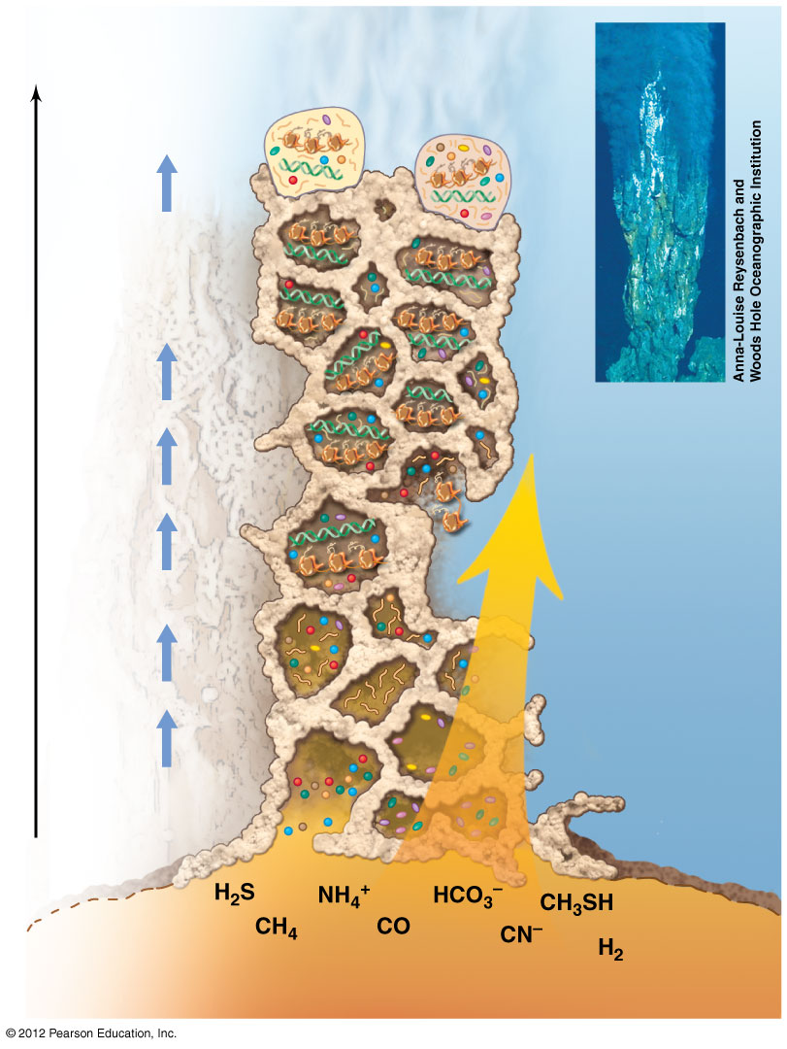
Origin of life: subsurface hypothesis
Subsurface was more constant in conditions
Anaerobic, lots of minerals available for energy.
Evolutionary events
Early Bacteria
Early Archaea
Dispersal to other habitats
Diversification of molecular biology, lipids, and cell wall structure
LUCA
Mound: precipitates of clay, metal sulfides, silica, and carbonates
(−0.3 to 0.5 billion years)
Time
DNA
Ocean water (<20°C, containing metals, CO₂ and PO₄²⁻)
RNA and proteins
RNA life
Flow of substances up through mound
Amino acids
Nitrogen bases
Prebiotic chemistry
Sugars
Ocean crust
Nutrients in hot hydrothermal water
Brock Biology of Microorganisms, 15th ed

